Slide 1
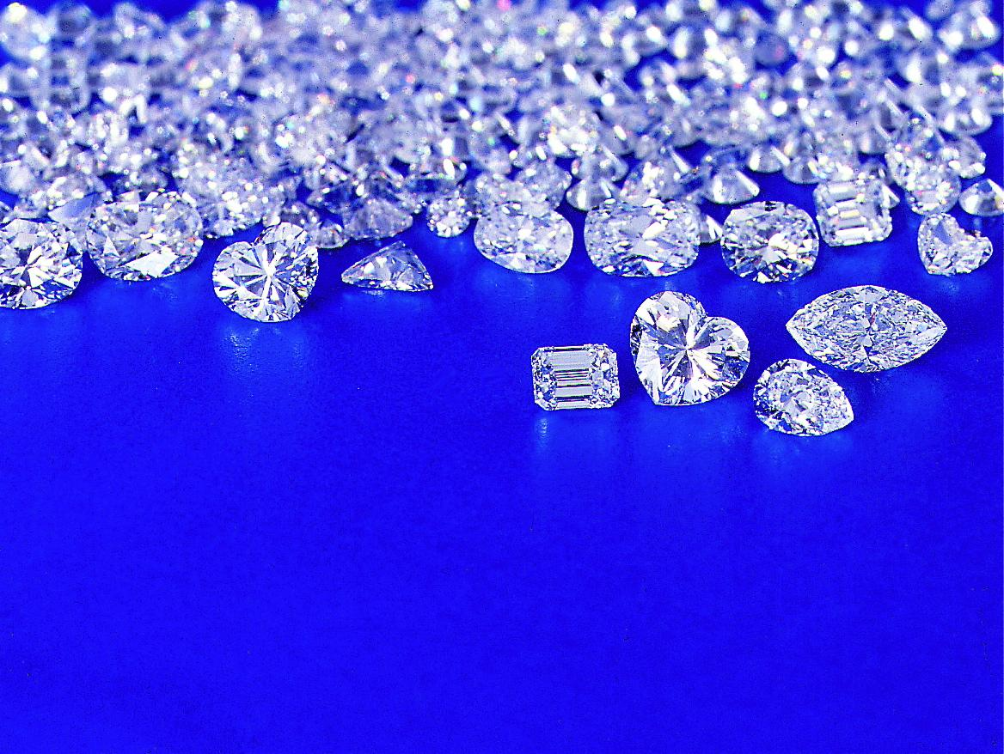
DIAMOND JEWELLERY RETAIL SENTIMENT STUDY 2011
SRIJANEE GOSWAMI
JADAVPUR UNIVERSITY

Slide 2
ABSTRACT

Slide 3
This project is the product of primary data collection and subsequent data analysis. Primary data was collected by interviewing diamond jewellery retailers in Kolkata in the latter half of December 2011, under the guidance of IMRB International (Abacus Business Operations). The syndicated data has been analyzed using various descriptive statistics & regression analysis.
The central theme of this project is to analyze the performance of diamond jewellery retailers in 2011 (with special emphasis on October to December 2011) and to also portray the diamond jewellery market scenario in 2011 (with special emphasis on October to December 2011).
Performance of any business can be assessed with the help of various factors. This project evaluates performance with respect to sales (value & volume). Another factor looked into is the frequency of stock turn. Market scenario evaluation is from the point of view of the retailers, by learning their perspective of factors affecting the diamond jewellery market. Probing into their pattern of diamond jewellery sales, an idea about the demand side of the diamond jewellery market can be formed. Analysis also brings out the market expectations of these retailers in 2012.

Slide 4
CONTENTS

Slide 5
IMRB INTERNATIONAL
TWO MONTHS AT IMRB INTERNATIONAL
DIAMOND JEWELLERY RETAIL SENTIMENT STUDY
DIAMOND JEWELLERY RETAIL SENTIMENT ANALYSIS
FINDINGS FROM STUDY
SUGGESTIONS FROM FINDINGS
LIMITATIONS OF STUDY
BIBLIOGRAPHY
ACKNOWLEDGEMENTS

Slide 6
IMRB INTERNATIONAL

Slide 7
COMPANY PROFILE
IMRB International is a multi-national market research, survey and business consultancy firm that offers a range of affiliated data and customized research services.
It was established in 1970, and now is a leading provider of market research in India as well as in South Asia, the Middle East and North Africa.
Headquartered in Mumbai, IMRB operates in 12 Indian cities and has associate offices in over 15 countries in the world.
It is a subsidiary company and was founded by Hindustan Thompson Associates (HTA), which is owned by Martin Sorrell’s WPP Group- the largest advertising group in the world.
IMRB is also aligned with the Kantar Group, one of the world’s largest research information, insight & consultancy network, also under the WPP canopy. IMRB is presently headed by Thomas Puliyel, a market researcher with over thirty years of experience.

Slide 8

With over 1200 employees IMRB International promises high quality conceptualization, strategic thinking, execution and interpretation skills on all its clients' research needs. It is the only research company in India today that offers the entire range of research based services to its clients.
IMRB has been responsible for establishing the first and only household panel, the first television audience measurement system and the first radio panel in the country and has played an important role in the development of market research in India.
It is also the oldest Indian market research company and has been rated the ‘Best Market Research Company’ by Market Research Society of India.

Slide 9
COMPANY SERVICES
IMRB International has been the pioneer in conducting market research exercises for several sectors. Today, there is hardly any sector that IT hasn't researched. From potato chips to computers chips, cigarettes to cellular phones, alcohol to air conditioners and bubble gums to big-sized cars, all has come under the purview of its research. IMRB has been operating in the following economic sectors:
Alcohol
Automotive
Agriculture and Agro-products
Building and Construction
Consumer Durable
Household Care
IT, Internet and Telecom
Industry and Business
Media and Entertainment
Social and Rural

Slide 10
IMRB’s clientele boasts of various blue chip companies in India and around the world. Some of its top clients are the BAT Group, Bharti Group, Cadbury, Ford Group, Frito Lay, Glaxo Smithkline, Heinz, Indian Airlines, ITC Group, Millward Brown, Nestle, Pepsi Group, Reckitt Benckiser, Research International, TVS Motors, Unilever Group, VST and so on.
Since its foundation in 1970, IMRB International has provided the following research services:
Advertising and Promotion research
Corporate and Employee research
Product and Packaging research
B2B and Industrial research
Customer satisfaction research
Strategic market research
Brand research
Mystery Shopper Insights (MSI)
Channel and retail research
Pricing research

Slide 11
BUSINESS DIVISIONS
The market research major is organized into several independent business divisions that concentrate on specific areas of market research. Presently it has eleven specialist units:
Abacus Business Operations (ABO)
Abacus Market Analytics
Abacus Research
The Business & Industrial Research Division (BIRD)
The Brand Science Group (BSG)
Customer Satisfaction Management & Measurement (CSMM)
Media and Panel Group (MPG)
Probe Qualitative Research (PQR)
Quantitative Research Wing
Social and Rural Research Institute (SRI)
IMRB Mindtech Systems & Software

Slide 12
TWO MONTHS AT IMRB INTERNATIONAL

Slide 13
I have been a field work intern at IMRB International’s Abacus Business Operations division and have worked on four projects spanning the months of December 2011 and January 2012. IMRB’s clientele consists of various blue chip companies in India and around the world. I have had the opportunity to work on projects commissioned by Bharti Airtel, ITC, Mahindra & Mahindra Limited and DeBeers UK.
The projects I have worked on in the two months are the following:
Project GATEKEEPER- Bharti Airtel
Wills Lifestyle Mystery Audit- ITC Limited
Customer satisfaction survey- Mahindra & Mahindra Limited
Retail Sentiment Study- DeBeers UK
I have chosen to concentrate on data collected for the Diamond Jewellery Retail Sentiment Tracker – a project commissioned by DeBeers UK and have done analysis on the same.

Slide 14
PROJECT GATEKEEPER
Bharti Airtel is the largest provider of mobile telephony and second largest provider of fixed telephony in India, and is also a provider of broadband and subscription television services. IMRB International was commissioned by Airtel to conduct a survey on its customers of Landline and Broadband services.
The Objective for this survey was to determine the customer’s perception of Airtel’s brand image and quality of its services, their satisfaction with its sales and after sales services and last but not the least to pool in complaints and valuable feedback & suggestions from its existing customers. Alongside the survey was conducted amongst non Airtel users, i.e users of its competition brands like Reliance, Tata or MTNL/BSNL and aimed to evaluate customer satisfaction with these brands as compared to Airtel.
The Target Group comprised of users and non-users of Airtel. While customers of Airtel were approached on basis of a database provided by it, non-users were approached randomly. The customers of these service providers covered big Corporations and Small & Medium Enterprises operating in different fields of work. Respondents with family members working in field of advertising/media, market research, telecommunications, distribution of broadband connections were not to be considered.
Total sample size for the survey was 430 inclusive of users of Airtel and its competition brands.
As an intern my work was to approach the customers enlisted in the Airtel database and interview them.

Slide 15
From the sample of size 24 that I collected and analysed, the findings are as follows:
35% of customers rated their service provider as ‘Good’ and only 5% rated as ‘Poor’
Among the Airtel customers, 50% considered Airtel to be the best brand, 35% went for BSNL, 10% opted for Tata and only 5% rooted for Relaince as the best brand.
On asked to rate price charged by their service provider, 52 % rated it ‘Moderate’, 43% thought it was ‘High’ and 5% considered price charged to be very high. However none rooted for the ‘Low’ or ‘Very Low’ options.
42% of the Airtel customers were ‘Very Likely’ to continue subscribing whereas 21% were ‘Not Very Likely’ to continue.
In the month of November 2011, none of the Airtel Landline customers reported of facing clarity in voice related problems, 97% of them did not face disconnections during conversations however a staggering 65% were not able to make a call in the first attempt.
47% of the Airtel Landline users rated the quality of installation work as ‘Good’, and only 5% rated ‘Poor’.
98% of the respondents had to contact Airtel Fault Repair team within 1-6 months before December 2011. The most common problem they had was that of landine disconnection.
All customers had interacted with Airtel Call Centre within 1-6 months before December and 88% of them rated the experience as ‘Poor’.
Barring 3 respondents all were satisfied with Airtel Payment Assistence Process.

Slide 16
WILLS LIFESTYLE MYSTERY AUDIT
The Wills Lifestyle chain of exclusive stores comes under the canopy of ITC Limited.
The objective of the mystery audit was to assess the overall customer experience at the store covering the critical points within the service lifecycle keeping in mind the customer expectations.
The mystery audits were carried out in the 4 Wills Lifestyle outlets in West Bengal; three situated in Kolkata and one in Siliguri. I was allotted to carry out audits in the Wills Lifestyle outlet, Shakespeare Sarani and Wills Lifestyle outlet, South City Mall in Kolkata.
To assess and compare the performance of the stores, a Store Evaluation Index was calculated which was inclusive of Visual Merchandise Index, Conformance Index and People Index.
The Shakespesre Sarani Outlet scored 88% while the South City Mall outlet scored 89% according to the Store Evaluation Index.
The findings of the mystery audit shall enable Wills Lifestyle to determine customer satisfaction and improve perceived levels of service; will report areas of strengths and weaknesses of each outlet; confirm the integrity of employees, company procedures and internal controls; and support an incentive program that will boost employee productivity & loyalty.

Slide 17
MAHINDRA & MAHINDRA CUSTOMER SATISFACTION SURVEY
Mahindra & Mahindra Limited (M&M) is one of the largest automobile manufacturers by production in India and a subsidiary of Mahindra Group conglomerate.
In addition to making groundbreaking Utility Vehicles like the Scorpio and Bolero, Mahindra offers cars, pickups, and commercial vehicles that are rugged, reliable, environmentally friendly, and fuel-efficient.
Commercial vehicle is a type of motor vehicle that may be used for transporting goods or passengers. Examples of commercial vehicles are trucks, semi-trucks (articulated lorry), vans, coaches, bus, taxicabs, trailers, box trucks etc. The range of commercial vehicles sold by M&M include Alfa, Gio, Mahindra Navistar Trucks, Bolero Maxi Truck, Genio, Loadking, Maxximo, Tourister Buses.
The target respondents of this survey were the users of M&M’s commercial vehicles.
This survey served the purpose of after sales customer satisfaction check by the company. For the same a database containing details of the customers were provided by M&M to IMRB International.
The survey was telephonic in nature and the interviews on an average spanned for about 15 minutes. The valuable feedback of seven of the users was taken.

Slide 18
DIAMOND JEWELLERY RETAIL SENTIMENT STUDY

Slide 19
De Beers: The Diamond Monopolist
De Beers is a family of companies that dominate the diamond, diamond mining, diamond hops, diamond trading and industrial diamond manufacturing sectors. As the world's leading diamond company for more than a century, the De Beers name is synonymous with diamonds. Together with its joint venture partners, De Beers employs approximately 16,000 people in operations around the world.
De Beers is active in every category of industrial diamond mining: open-pit, underground, large-scale alluvial, coastal and deep sea. Today the De Beers family of companies is involved in most parts of the diamond value chain. The companies are De Beers Canada – mining, De Beers Consolidated Mines – mining, De Beers Diamond Jewellers – retail, Debswana – mining, Diamdel – trading, Diamond Trading Company – trading, Diamond Trading Company Botswana – trading, Diamond Trading Company South Africa – trading, Element Six – Advanced Materials / industrial diamond, Forevermark – retail, Namdeb – mining and Namibia Diamond Trading Company – trading.
De Beers Consolidated Mines was formed in 1888 in South Africa by Barney Barnato and Cecil Rhodes. Ernest Oppenheimer took over the chairmanship of the company in 1927.
By 1902, De Beers controlled 90% of the world's diamond production. A worldwide decline of diamond prices in the 1930s led the Oppenheimer family to begin their world famous marketing campaign in 1947, "A diamond is forever”. This later became the company’s official motto.

Slide 20
Having conquered the United States by the 1960s, De Beers set its sights on new territories. By 1981, almost 60 percent of Japanese brides wore diamonds, up from 5 percent in 1967.
De Beers reported a 74 percent increase in profits in the first half of 2011 alone. And the number of De Beers stores worldwide rose from just one in 2001 to 39 in 2008, with 17 in Asia alone.
In November 2011 De Beers ended its 80 year stranglehold on diamonds when the Oppenheimer family sold their 40 per cent stake in the company to mining giant Anglo American Plc for over US$5 billion. The transaction is currently proceeding through a regulatory review process, with completion expected during the second half of 2012.
DeBeers UK commissioned IMRB International to carry out a Retail Sentiment Survey among diamond jewellery retailers in Kolkata. This project analyses the data which was collected for the same.

Slide 21
OBJECTIVE OF STUDY
The Objective of this study is four fold, they are explained below:
To evaluate the performances of the 30 randomly selected diamond jewellery businesses in Kolkata in the year 2011 (with special emphasis on the period October-December 2011)
Evaluating the recent trends in the diamond jewellery market
Performance evaluation with respect to the type and scale of jewellery businesses
To find out the strong determinants of sales performance of diamond jewellery businesses and their extent of influence.
The Target Group for the purpose of the Retail Sentiment Study was that of the jewellery retailers across Kolkata who sell diamond jewellery among others. The primary survey was to cover not only those retailers who exclusively sell diamond jewellery and are renowned in the market for the same but also those jewellery houses whose bulk of revenue comes from non-diamond jewellery sales. This has aided in doing away with any kind of bias arising in data analysis.
The Target Respondents were the shop owners/ store managers of jewellery stores, i.e. persons well acquainted with the state of the stores’ jewellery sales and the condition of the diamond jewellery market.

Slide 22
The Target Sample Size of this project was decided by the engineers of the questionnaire to be 50 respondents. Statistically speaking, a sample of size greater than equal to 30 is considered a large sample and such samples do a better job of capturing the features of the data population than small samples.
The Target respondent profile for Diamond Retail Sentiment Survey is presented below:
Type of retailer | Number of retailers
Independent Jewellery Store (with 1-4 stores) | 26
Small Chain of Independent Jewellery Store (with 5-19 stores) | 20
Large Chain Store (with 20+ stores) | 4
Sample size | 50

Slide 23
RESEARCH METHODOLOGY
The primary survey for the Retail Sentiment Study was carried out with the help of the retailers’ database provided by DeBeers. A sample of retailers was constructed keeping in mind the essence of stratified sampling. However a few independent jewellery stores approached were not listed in the database. These were selected randomly by field personnel.
Retailers were interviewed on the basis of the questionnaire designed by IMRB International. Type of questions included in the questionnaire serves the purpose of obtaining a basic idea about the sales and stock scenario and market expectations of the respondents.
The questionnaire comprises of the following sections:
    Demographic Details of Respondents – Name of store owner/ store manager, name of retail store, location of store, contact details, type of retailer etc.
    Overall Economic Outlook And Competition Presence – type of jewellery stocked, diamond jewellery sales performance in 2011, number of pieces sold in October-December 2011, average price of product, bestselling product in October-December 2011 etc.

Slide 24
3. Diamond Jewellery Details – price range, size, clarity, colour, cut of bestselling items, their respective contribution in sales 2011, methods used to boost sales etc.
4. Sales and Inventory – current inventory of diamond jewellery and cut & polished diamonds, stock turn frequency, sales to stock ratio etc.
5. Future Outlook: Growth, Its Drivers And Overall Industry -- expectations regarding sales in 2012
6. Branded Diamond Jewellery—diamond brands stocked, opinion about the factors positively and negatively affecting the diamond jewellery market.

Slide 25
SAMPLING TECHNIQUE
In the context of this Retail Sentiment Study, the data population is comprised of all the diamond jewellery retailers in Kolkata. Identifying and locating them, interviewing them is rather infeasible. Thus only a subset of this population has been probed into, comprising 50 retailers.
IMRB International (Abacus Business Operations) was commissioned by DeBeers UK to conduct a Retail Sentiment Study and for the same was provided with a database containing an exhaustive list of diamond jewellery retailers across Kolkata.
To meet the target of 50 retailers the method of sampling followed was that of purposive sampling from the database.
The sample cof i) Independent jewellery store (with 1-4 stores), ii) Small Chain of Independent Jewellery store (with 5-19 stores), iii) Large Chain store (with 20+ stores). While constructing the sample more importance was given to jewellery retailers with less than 19 stores as these types occur more in the population as compared to the large retailers.
In this project I have dealt with a subset of the sample size (50) for the Retail Sentiment Study executed by IMRB. A sample size of 30 retailers has been considered. This is again a stratified sample giving more relative importance to small and medium scale retailers as compared to the big retailers. Also this is a large sample.

Slide 26
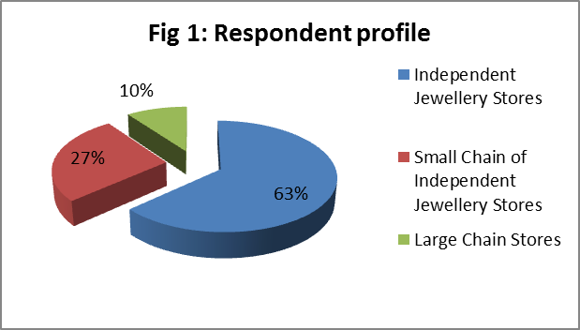
RESPONDENT PROFILE
The purposive sample of 30 worked with takes into account the fact that total supply of diamond jewellery in the market comes from small scale, medium scale and large scale retailers. While there are numerous small and medium scale retailers, the number of the big jewellery houses present in India is relatively small. There is predominance of Independent jewellery stores in the diamond jewellery market as far as their existence is concerned. These are the backbone of the Indian jewellery market. Apart from providing employment opportunities for the teeming millions these entities contribute positively to the growth of the Indian jewellery industry in general. The sample captures this. The sample respondent profile is presented below:
Type of retailer | Number of retailers
Independent Jewellery Store (with 1-4 stores) | 19
Small Chain of Independent Jewellery Store (with 5-19 stores) | 8
Large Chain Store (with 20+ stores) | 3
Sample size | 30

Slide 27
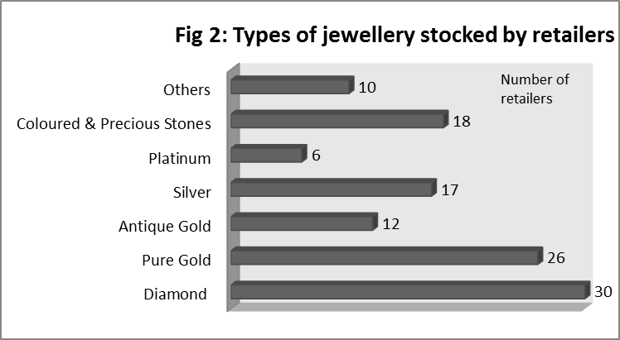
The jewellery retailers to be interviewed were randomly chosen from the retailers’ database provided by DeBeers covering a large number of jewellery shops spread across Kolkata. Since this survey is on diamond jewellery retailers all the jewellers necessarily stocked diamond jewellery.
A large number of the retailers; 26 of them stocked Pure gold jewellery, 12 retailers also stocked Antique gold jewellery, 17 stocked Silver jewellery, 6 of them stocked Platinum Jewellery, 18 retailers stocked Coloured & Precious stone jewellery while 10 retailers sell Other types of jewellery (pearl, white gold, beaded jewellery etc.)
A large number of the retailers, large or small, stocked Pure gold jewellery which shows the market trend and high demand for gold in Kolkata. Platinum jewellery was stocked by the least number of jewellers, none of which were Independent jewellery stores. Coloured and other precious stone jewellery are increasingly becoming popular.

Slide 28
DIAMOND JEWELLERY RETAIL SENTIMENT ANALYSIS: A General Analysis

Slide 29
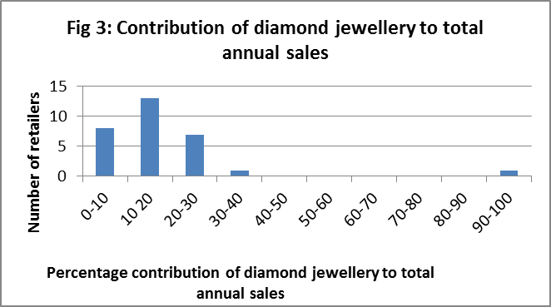
Contribution of diamond jewellery to total annual sales
To understand the importance of diamond jewellery sales in total annual sales of the 30 retailers; a frequency distribution has been constructed after grouping data into 10 equal class intervals, each of which correspond to a range of percentage contribution of diamond jewellery to total annual sales. The histogram below is a graphical representation of the same.
Before finding the measure of central tendency (here Arithmetic Mean) the outlier has to be treated. Outlier is an extreme data point which creates a bias in calculation of mean and thus should be eliminated. The outlier in this case is the percentage contribution of diamond jewellery in total annual sales of the retailer Asmi, which sells only diamond jewellery. Since diamond sales constitute 100% of its overall sales, including it would create a bias. Weighted Mean is calculated from the 29 data points using the expression:
Arithmetic Mean = S f x / S f ,
x= Midpoint variable,
f= Frequency or number of retailers
The value of A.M. derived is 15.34483,
(approx. 15), i.e. the average contribution
of diamond jewellery to total annual sales
of the 29 retailers is about 15%.

Slide 30
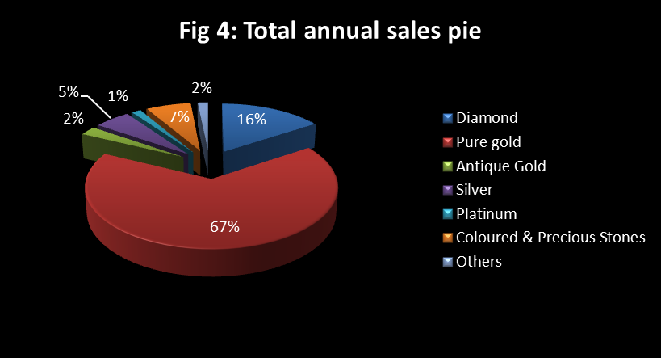
For 29 out of 30 retailers it has been found that diamond jewellery sales constitute less than 40% of total annual sales and this is irrespective of the variety of other types of jewellery they stock in their showroom. Diamond sales contributes the lowest (2%) for H.P.Sirkar Jewellers which stocks Diamond, Pure Gold, Silver, Coloured & Precious stones and Other types of jewellery and the highest (40%) for Priyo Jewellers which interestingly stocks the same variety. Only one retailer, (which has been treated separately) who specializes in diamond jewellery sales has obviously a 100% sales contribution.
Average sales contribution of other types of jewellery has been also computed using similar method as that of diamond jewellery and the results are presented below. It is observed that Pure Gold jewellery dominates the total annual sales pie on an average, followed by diamond jewellery. Platinum contributes the least.
Type of Jewellery | Average contribution in total annual sales
Diamond | 15.344 %
Pure gold | 67 %
Antique gold | 2.413 %
Silver | 5.344 %
Platinum | 1.379 %
Coloured & Precious stones | 6.724 %
Others | 1.551 %
Total | 99.78% (approx. 100 %)

Slide 31
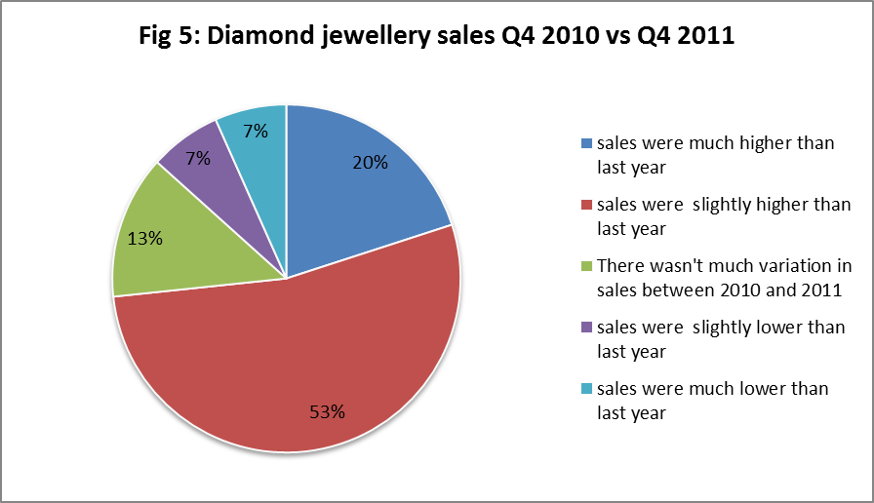
Diamond jewellery value sales: Q4 2011 VS Q4 2010
This section looks into diamond jewellery sales scenario experienced by retailers in October – December 2011 as compared to 2010. The retailers were asked to roughly categorise sales performance on basis of ‘much higher sales’, ‘slightly higher sales’, ‘not much variation in sales’, ‘slightly lower sales’ and ‘much lower sales’. Their reports are portrayed with the help of the pie chart.
A staggering 16 (53%) retailers had slightly higher sales in Oct-Dec 2011 as compared to Oct-Dec 2010. As is evident from the pie chart, 73% of the retailers faced higher sales as opposed to 14% who reported of sales declining in Q4 2011.

Slide 32
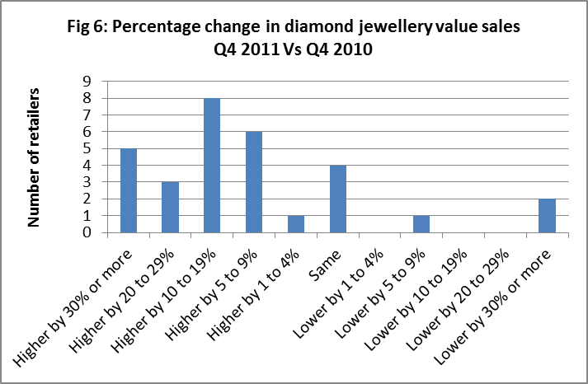
Now these same retailers were asked to report approximate percentage changes in diamond jewellery rupee sales in Q4 2011. Percentage changes were reported on the basis of 11 ranges. The histogram below presents their reports:
Thus, it is found that most retailers had experienced 10% to 19% increment in value sales in Quarter 4 2011 as compared to the same period in 2010.

Slide 33
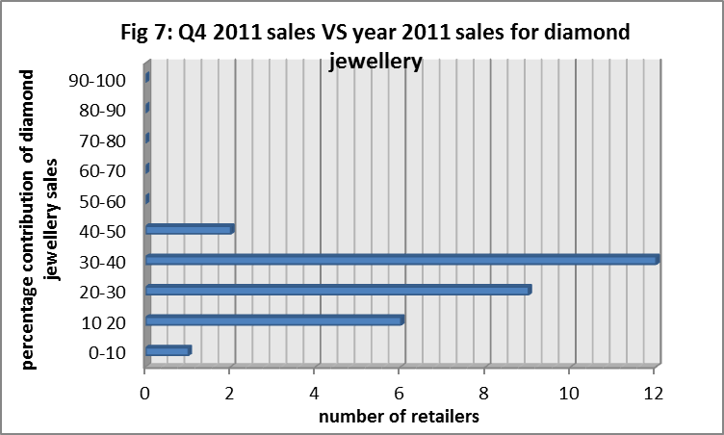
Diamond jewellery value sales: Q4 2011 VS Year 2011
This section attempts to draw a comparison between diamond jewellery sales of the participating retailers in Q4 2011 and in the entire year of 2011. The respondents were asked to comment on the proportion contribution of the last quarter sales to that of the entire year. Their reports have been presented below in the histogram.
For all 30 retailers Q4 sales of diamond jewellery has been less than 50% of total annual sales in 2011. For most retailers (40%) Q4 2011 sales have been 30%-40% of annual sales. The median, a measure of central tendency can be used to evaluate a central value for the variable under consideration.
Median = N+1/2, where N is sample size and it is even
=15.5
Median is the observation between 15th and 16th values, and it is 30. Thus the median percentage contribution of Q4 diamond jewellery sales is 30%. For only one retailer Q4 sales has been very low (10%) and two retailers achieved Q4 sales as high as 45%. Q4 2011 sales have been substantially high for a majority of jewellers. An obvious explanation is that Q4 (October-December) spans the Indian wedding season and also accommodates the biggest Indian festival, Diwali.

Slide 34
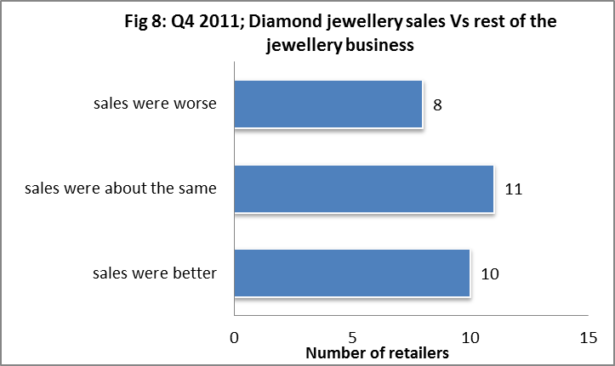
Performance of Q4 2011 diamond jewellery sales as compared to rest of the jewellery business
Most of the retailers interviewed sell various types of jewellery apart from diamond. For a majority of them sale of pure gold jewellery forms the bulk of jewellery sales. Respondents were asked to comment on the performance of diamond products in Q4 2011. They were required to categorise sales performance on basis of three benchmarks – ‘sales were worse’, ‘sales were about the same’ and ‘sales were better’. Exact proportion figures were not asked to be reported.
The bar graph below portrays that for a subtle majority of respondents diamond jewellery sales performed about the same as sales of other types of jewellery. For 10 retailers sales performance was better. Only 8 out of 29 retailers (27%) complained of poor diamond jewellery sales. Here, to evaluate comparative sales performance the observation of the exclusive diamond outlet (Asmi) has not been taken into consideration.

Slide 35
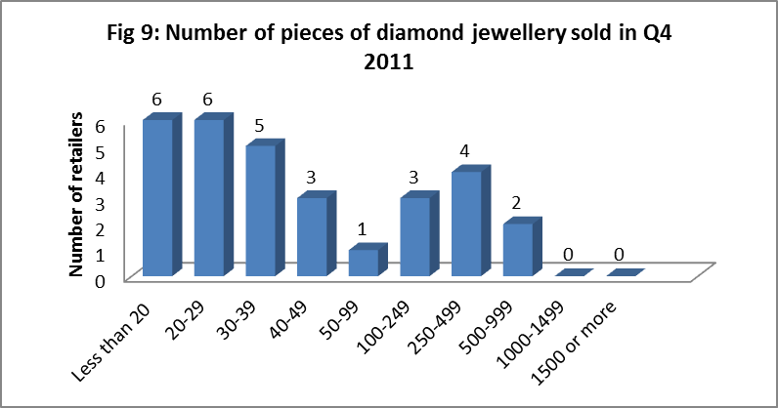
Diamond jewellery pieces sold: Q4 2011
Retailers were asked to report the approximate number of jewellery pieces they sold in October to December 2011. Their reported figures have been sorted into 10 categories. The same information has been presented below diagrammatically.
From the Histogram it is evident that 40% of the retailers had sold less than 29 pieces and 70% (21retailers) of them sold less than 99 pieces of diamond jewellery on Q4 2011. None sold above 1000 pieces, not even the exclusive diamond jewellery outlet.

Slide 36
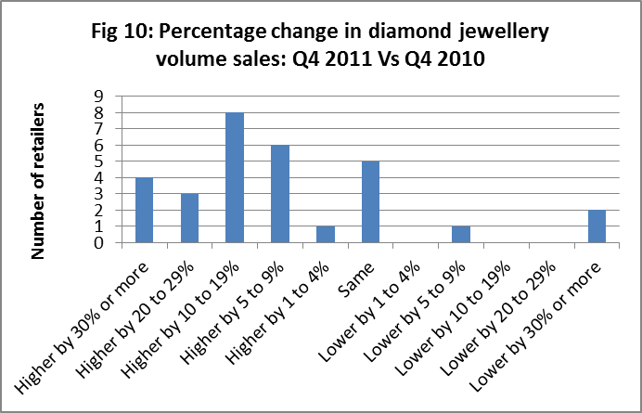
Diamond jewellery volume sales: Q4 2011 VS Q4 2010
This section looks into percentage change in the number of diamond jewellery pieces sold in Q4 2011 as compared to Q4 2010. The retailers gave their reports based on 11 percentage change ranges. Their reports are presented in the following histogram.
A majority of the retailers reported of experiencing a satisfying Oct-Dec 2011 when their volume sales (pieces sales) went up by 10% to 19%, as compared to Oct-Dec 2011.

Slide 37
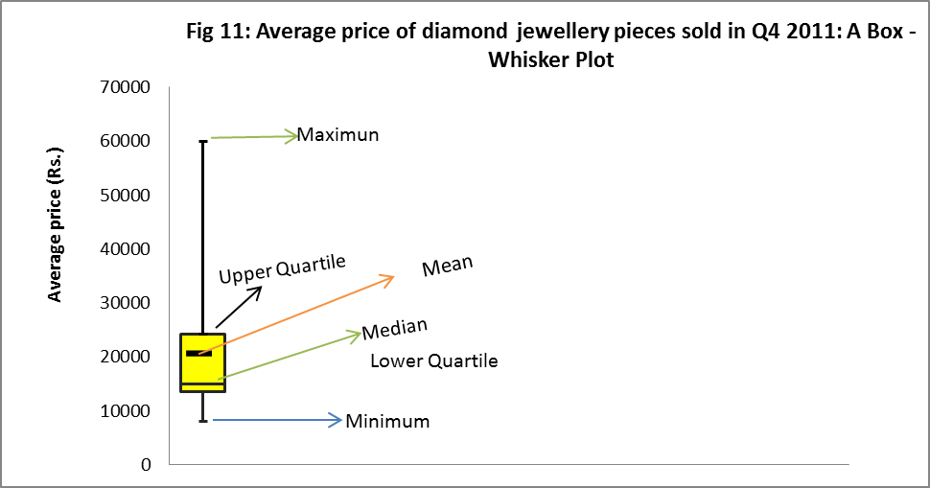
Average price of diamond jewellery pieces sold: Q4 2011
The approximate average price of diamond jewellery pieces sold in Q4 2011 ranged from Rs. 8,000 (Minimum) to Rs. 60,000 (Maximum). The accurate average price calculation for each retailer is fairly complex. However in this survey they have been asked to report an approximate figure, keeping in mind the best-selling item of Q4 2011 and its corresponding best selling price range.
The box-plot shows the distribution of average price of jewellery pieces sold in Q4 2011. It is evident from the positive skew (asymmetricity towards lower values) of the data that bulk of the distribution is concentrated below 25,000, i.e for most retailers average price is less than or equal to Rs. 25,000. Below the lower quartile (Rs. 13500) lies 25% of the data points (prices). 50% of the price distribution lies below the Median (Rs. 15000), i.e half the retailers have an average price less than or equal to Rs. 15000. Only 25% of the average prices reported lie above the upper quartile (Rs. 24250). The Mean average price is Rs. 20,000 and is quite different from the Median as it has become biased due to a asymmetric data distribution. Thus Median is referred to as the measure of central tendency here.

Slide 38
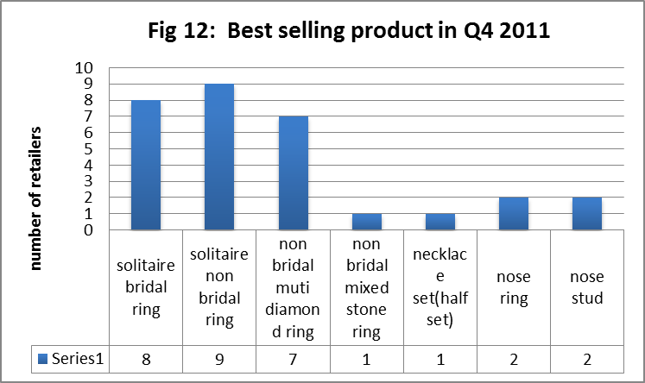
Top three best-selling diamond products: Q4 2011
Each retailer was asked to report the top three best-selling items in October to December 2011.The best-selling product is the most sold diamond jewellery type with regard to number of pieces.
Solitaire non bridal ring emerged as the best-selling product among majority of the retailers in Q4 2011.What is also considered the Indian wedding season, the period Oct-Dec saw a considerable demand for finger rings among other types of jewellery. The perfect wedding is incomplete without an engagement ring and what is more perfect than a solitaire ring. Solitaire non bridal rings are more popular among buyers than solitaire bridal rings. Solitaire rings in general seem to be buyers favourite. For a staggering majority of the retailers diamond rings have done good business.

Slide 39
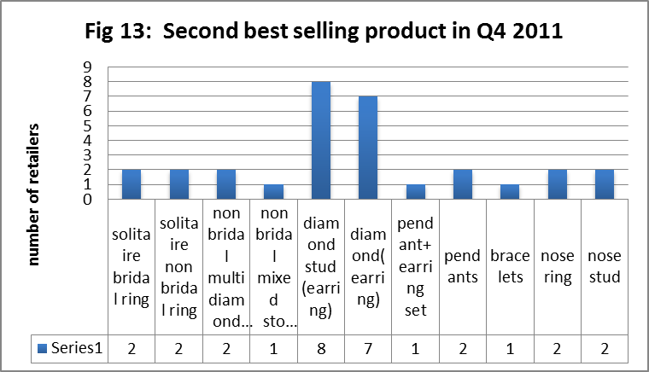
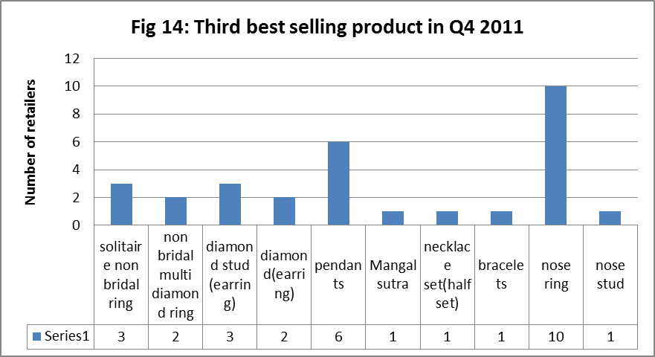
Diamond stud (earrings) emerged as the second most sold jewellery by majority of the retailers. Diamond earrings also did well in the market. While finger rings are most in demand, earrings occupy the second position.
Nose rings emerged as the most reported third best selling product of Q4 2011, closely followed by Pendants. The type of nose ring particularly in demand is the bridal nose ring. Sporting a nose ring by the Indian bride is not just a fashion statement in India; rather it is a cultural demand and age-old tradition. These are well known as ‘nath’ in India and are available in the market in exquisite combinations of metals and precious stones.

Slide 40
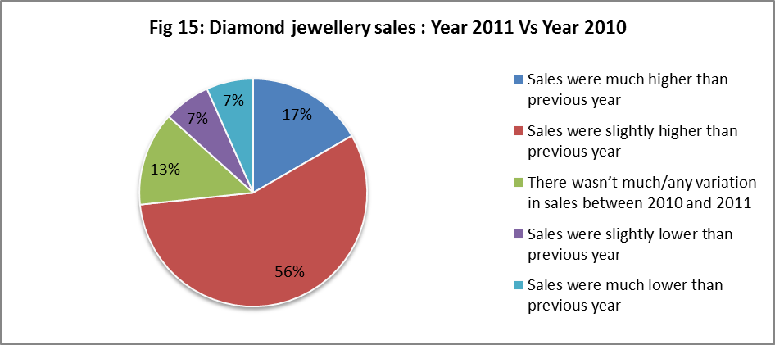
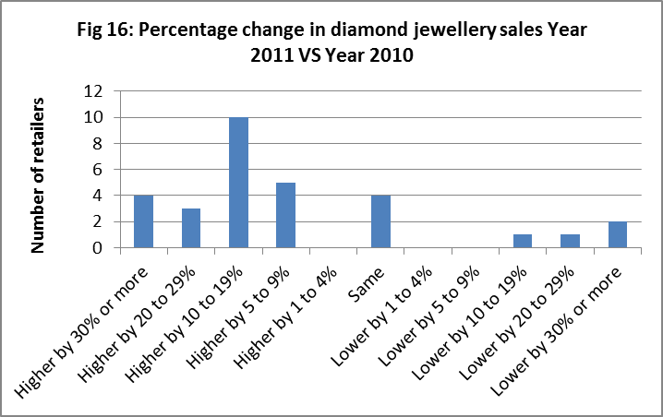
Diamond jewellery value sales: Year 2011 VS Year 2010
This section looks into diamond jewellery sales of retailers in the entire Year 2011 as compared to 2010. The retailers were asked to roughly categorize sales performance on the basis of ‘much higher sales’, ‘slightly higher sales’, ‘not much variation in sales’, ‘slightly lower sales’ and ‘much lower sales’. Their reports are portrayed with the help of a pie chart.
The pie chart (Fig 15) shows that majority of the retailers (73%) were better off in 2011 as far as diamond jewellery sales is concerned. 17% of them even experienced very high sales as compared to 2010. Only 14% felt 2010 was a better financial year for them than 2011.
The retailers were also enquired about the percentage variation in their sales from 2010 and 2011. Their reports have been represented in tabular manner as well as graphically using a Histogram (Fig 16).
The modal value of the distribution is clearly the range ‘Higher by 10 to 19%’. This implies that for majority of the retailers diamond jewellery sales in 2011 increased by 10 to 19%, a slight increment.

Slide 41
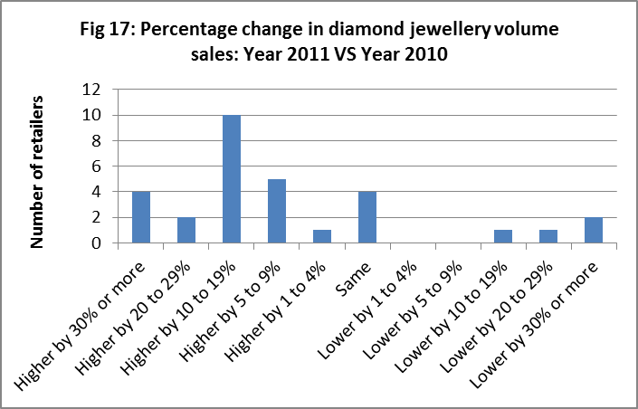
Diamond jewellery volume sales: Year 2011 VS Year 2010
The retailers were enquired about the percentage variation in their volume sales in the entire year 2010 and 2011. Their reports have been represented graphically using a Histogram.
Volume sales i.e. the number of pieces of jewellery sold in 2011 have been slightly higher than in 2010 for most retailers. The modal value of the distribution is the range ‘Higher by 10% to 19%’ i.e. for most retailers the number of pieces of diamond jewellery sold in 2011 increased by 10 to 19%. Only 4 out of 30 retailers reported of having lower sales than in 2010.

Slide 42
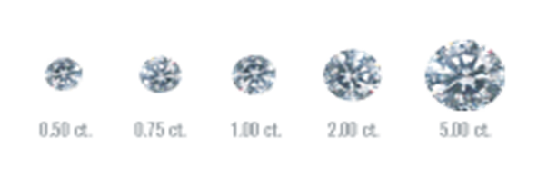
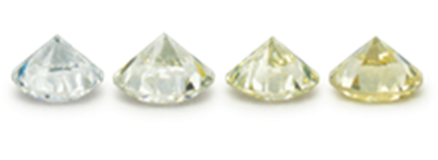
The determinants of diamond quality
Because diamonds are so valuable, it’s essential to have a universal grading system for assessing their quality. In the 1940s and ’50s, Gemological Institute of America (GIA) developed the 4Cs and the GIA International Diamond Grading System to objectively compare and evaluate diamonds. This is the world’s most recognized system of evaluating a diamonds quality and value. Each grade describes a different aspect of the diamond and it is only the sum total of all these characteristics which will determine if the diamond is a true gem or just a commercial grade. The four Cs are Carat, Colour, Clarity and Cut.
Carat: Diamonds and other gemstones are weighed in metric
carats: one carat is equal to 0.2 grams, about the same weight
as a paperclip. A carat is divided into 100 points. A a 50-point
diamond weighs 0.50 carats. The majority of diamonds used in
fine jewellery weigh one carat or less. Because even a fraction of
a carat can make a considerable difference in cost, precision is crucial.
Colour: Diamond colour is all about what cannot be seen. Diamonds
are valued by how closely they approach colourlessness – the less
colour, the higher their value. The GIA colour grading scale begins
with the letter D, representing colourless, and continues with
increasing presence of colour to the letter Z, or light yellow or brown.
Each letter grade has a clearly defined range of colour appearance.
Many of these colour distinctions are so subtle as to be invisible to
the untrained eye. But these slight differences make a very big
difference in diamond quality and price.

Slide 43
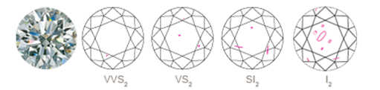
Clarity: Because diamonds formed deep within the earth, under extreme heat and pressure, they often contain unique birthmarks, either internal (inclusions) or external (blemishes). Diamond clarity refers to the absence of these inclusions and blemishes. Diamonds without these birthmarks are rare, and rarity affects a diamond’s value. Using the GIA International Diamond Grading System, diamonds are assigned a clarity grade that ranges from flawless (FL) to diamonds with obvious inclusions (I3).
Flawless (FL) - No inclusions or blemishes are visible to
a skilled grader using 10× magnification
Internally Flawless (IF) - No inclusions and only blemishes
are visible to a skilled grader using 10× magnification
Very, Very Slightly Included (VVS1 and VVS2) - Inclusions
are difficult for a skilled grader to see under 10× magnification
Very Slightly Included (VS1 and VS2) - Inclusions are clearly
visible under 10× magnification but can be characterized as minor
Slightly Included (SI1 and SI2) - Inclusions are noticeable to a
skilled grader using 10× magnification
Included (I1, I2, and I3) - Inclusions are obvious under 10×
magnification and may affect transparency and brilliance.

Slide 44
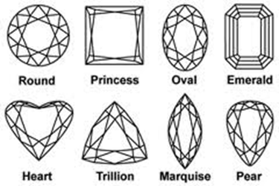
Cut: This is the factor that fuels a diamond’s fire,
sparkle and brilliance. Though extremely difficult
to analyze or quantify, the cut of any diamond has
three attributes: brilliance (the total light reflected
from a diamond), fire (the dispersion of light into
the colors of the spectrum), and scintillation (the
flashes of light, or sparkle, when a diamond is moved).
The cut scale according to GIA grading goes Excellent,
Very Good, Good, Fair or Poor. An understanding of
diamond cut begins with the shape of a diamond. The
standard round brilliant is the shape used in most
diamond jewellery. All others are known as fancy
shapes. Traditional fancy shapes include the marquise,
pear, oval and emerald cuts. Hearts, cushions,
triangles and a variety of others are also gaining
popularity in diamond jewellery.

Slide 45
Carat, Clarity & Colour used by retailers
This section looks into the most used and for that matter the most sold carat, clarity & colour of diamonds. This has been done by looking at their respective use in the bestselling items of these 30 retailers in Q4 2011. As discussed previously the bestselling product for Q4 2011 for a majority of the retailers had been solitaire non bridal ring, followed by solitaire bridal ring. Looking into the profiles of the retailers the following has been found:
Out of the 9 retailers who reported that solitaire non bridal ring was their bestselling product in Q4 2011;
55% used 0.02 to 0.07 carat diamonds, 33% used 0.08 to 0.17 carat diamonds while the remaining 12% used 0.18 to 0.29 carat diamonds in solitaire non bridal rings.
55% used diamonds of clarity VS1 & VS2, 33% used Si1-3 and 12% used VVS1 & VVS2.
66% used diamonds of colour G/H, 22% used I/J/K/L colour and rest 12% used the highest grade, D/E/F.
55% said solitaire non bridal rings sold in the range of Rs. 10,000 to Rs. 25,000 while for remaining 45% the same was sold for less than Rs. 10,000.
Out of the 8 retailers who reported solitaire bridal ring to be the best selling product in Q4 2011;
37% of them used diamonds of size 0.18 to 0.29 carats in solitaire bridal rings, 25% used 0.08 to 0.17 carat stones while the remaining13% used diamonds of weight less than 0.02 carats.
50% of them used VVS1 & VVS2 clarity stones, 25% used Si1-3 while the remaining 25% used IF/FL and VS1 & VS2.
50% used G/H colour diamonds, 25% used D/E/F and another 25% used I/J/K/L.
For an overwhelming 88% solitaire bridal rings in price range Rs. 10,000 to Rs. 25,000 sold the most, while for the remaining 12% the same product sold in price range of Rs. 25.000 to Rs. 50,000.

Slide 46
For the 7 retailers whose best selling product was non bridal multi diamond ring in Q4 2011;
57% used diamonds of size 0.02 to 0.07 carats, 14% used 0.08 to 0.17 carats, another 14% used 0.18 to 0.29 carats, while remaining 14% used large sized stones of 0.50 to 0.99 carats.
57% used VS1 & VS2 clarity diamonds, 28% used Si1-3 while rest 14% used VVS1& VVS2.
71% used diamonds of colour G/H, the rest used I/J/K/L.
42% said their bestselling product sold for less than Rs. 10,000, for 28% it sold in the range Rs. 10,000 to Rs. 25,000 while for the remaining it sold in range Rs. 25,000 to Rs. 50,000.
Both the retailers for whom nose ring was the bestselling product in Q4 2011 diamonds of 0.02-0.07 carats, Si1-3 clarity and of G/H colour were used. Both sold the product for less than Rs. 10,000. For both jewellers with nose stud as the bestselling product, diamonds of size less than 0.02 carat & 0.08 to 0.17 were used along with clarity VS1 & VS2 and colour D/E/F.
The retailer with non-bridal multi mixed stone ring as bestselling item, used diamonds of 0.08 to 0.17 carats, VS1 & VS2 clarity and G/H colour. The retailer with half necklace set as the bestselling item used diamonds of 1-1.99 carats, VVS1 & VVS2 clarity and G/H colour.
Thus summing up, as far is their bestselling product is concerned, for most retailers jewellery belonging to the price range of Rs. 10,000 to Rs. 25,000, of clarity VS1 and VS2, carat range (or size) of 0.02 to 0.07 carats and of colour G/H sold the most in Q4 2011.

Slide 47
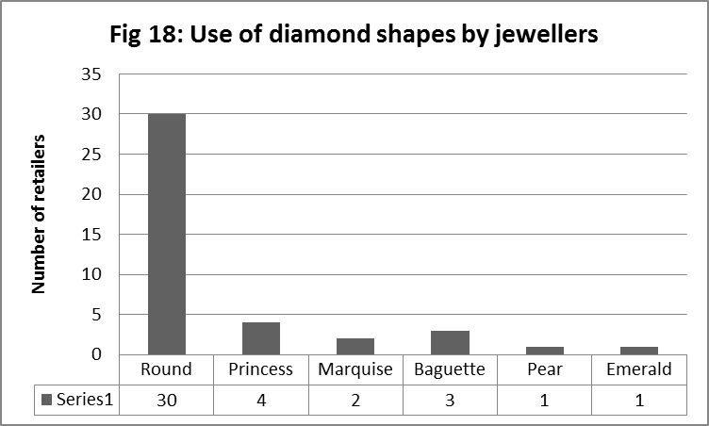
The most popular diamond cut
It has been found that all the 30 retailers who have been interviewed use round cut diamonds in making jewellery. In fact the round brilliant cut diamond is the most popular and most researched diamond shape available around the world today. It is the best choice in terms of saleability, insurability and desired optics. The round brilliant diamond provides a balanced return of light (brilliance) and dispersion. Round diamonds are the most versatile of all the diamond shapes since they can be used in a wide variety of types of jewellery and in many styles. Their brilliance and sparkle produce exceptional beauty.
Princess cut diamonds were used by 4 retailers
suggesting their lesser popularity as compared
to round cuts. Indeed princess is the second
most popular cut in the world. The princess cut
is a relatively new diamond cut, having been
created in the 1960s and has gained in
popularity in recent years.
Baguette cuts were used by 3 retailers, and
only two retailers used Marquise cuts. Pear
and Emerald cuts were used by only two
jewellers. Other diamonds cuts like Asscher,
Radiant, Cushions, Oval, Tappers,Trillion,
Heart shaped etc were used by none of the
30 retailers.

Slide 48
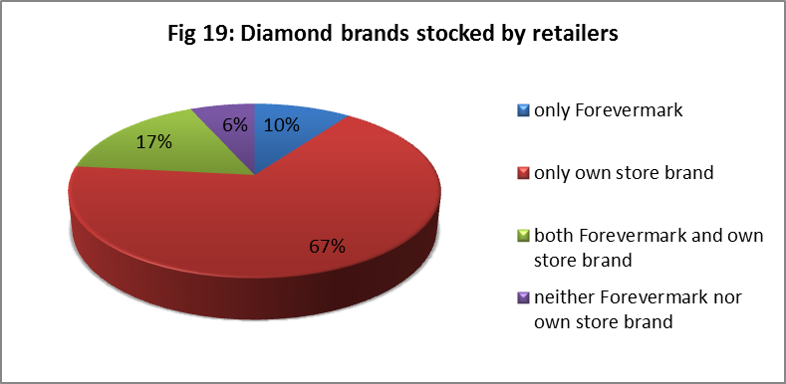
Diamond brands stocked in outlets
Diamond companies create their own diamond shapes, which they name, trademark and market as their unique brand. These are branded diamonds. Companies market a branded diamond in an effort to create a niche and distinguish themselves from their competition. A "brand" in any industry, especially the diamond industry should be synonymous with a higher standard of quality and craftsmanship. In this context, the brand adds value to the product. From a marketing standpoint, there are basically three types of branded diamonds - manufacturer brands, major chain brands, and smaller private label brands. Some popular diamond brands (these diamonds are all marketed by their respected companies.) are: Forevermark, Hearts on Fire Diamonds, Blue Nile Signature Diamonds, Tiffany Ideal Cut Diamonds etc. In India popular diamond jewellery brands are Tanishq and those under the canopy of Gitanjali Group namely Nakshatra, D'damas, Gili, Asmi, Sangini, Giantti, World of Solitaire, Shuddhi, Diya and others.
Forevermark is the diamond brand from
the De Beers group of companies.
The pie-chart portrays the type of branded
diamond products which the 30 retailers
stock in their outlets. Most retailers (67%)
stock their own store brand. In fact today
more and more diamond retailers all over
the world are coming up with their own
brands and it is becoming difficult to keep
track of them. Among these retailers is the
exclusive Asmi outlet which is a brand of the
Gitanjali Group. Only 10% of the retailers
stock exclusively Forevermark diamonds.

Slide 49
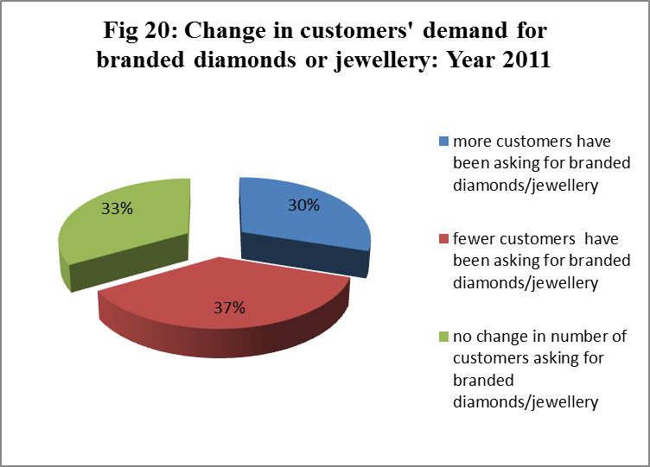
Change noted by retailers in the number of customers asking for branded diamonds or branded diamond jewellery: Year 2011
Retailers interviewed include Tanishq- which sells its own diamond brand. Other jewllers stock various diamond brands of the Gitanjali Group. Some of them store other less popular brands or don’t stock branded diamonds at all. They were asked about the scenario of customers’ demand for branded diamond products in 2011. Their reports have been portrayed in a pie-chart.
A majority of the retailers noted a decline in the number of customers asking for branded diamonds/jewellery.

Slide 50
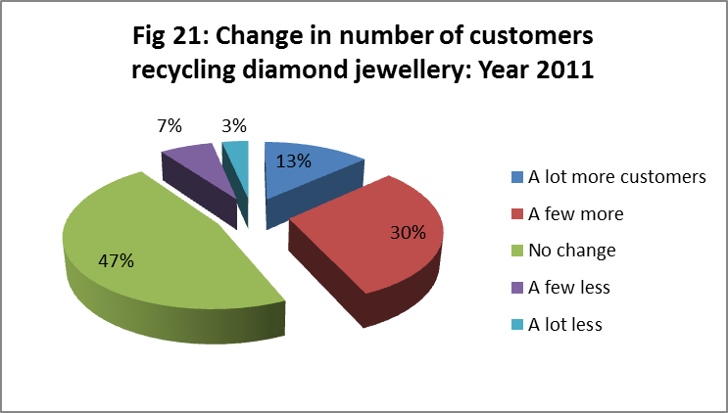
Change noted in the number of customers bringing in diamond jewellery to sell in 2011
Recycling diamond jewellery basically means their resale by customers. Local pawn shops as well as many jewellery stores purchase unwanted jewellery at a fair price. Benefit for the customers from this process is that they can get ready cash in time of their need. Diamond recycling is good for the environment because it prevents the mining of diamonds which can be harmful to the planet due to the harsh digging and drilling that is associated with the process. The diamond industry now encourages recycling diamonds to meet the ever-rising demand for it. Recycled diamonds are also considered to be non-conflict diamonds. A conflict diamond is a diamond that has caused wars where many people have lost their lives for its possession. Conflict diamonds are also known as blood diamonds.
However growing influx of "used" jewellery may stagnate market price over the long term despite the supply restraints and this is exactly what analysts fear in the upcoming years. Huge supply of recycled diamond jewellery is likely to hurt the mining industry. $1 billion worth of recycled diamonds are expected to be put back into the market by the end of 2012. According to Chaim Even-Zohar, CEO of Israel's Tacy Ltd Diamond Consultants, the huge influx of used diamond jewellery in the market in recent years implies that consumers don’t consider diamonds to be the best store of their wealth.
In 2011 around 43% of the retailers noticed
a rise in customers bringing in diamond
jewellery to sell while only 10% noticed a
decline in the same. Though this result
emanates from a sample of limited size, it
indicates that there has been a substantial
influx of used diamond jewellery in the
Kolkata jewellery market and suggests that
customers here still do not consider
diamonds to be the best investment.

Slide 51
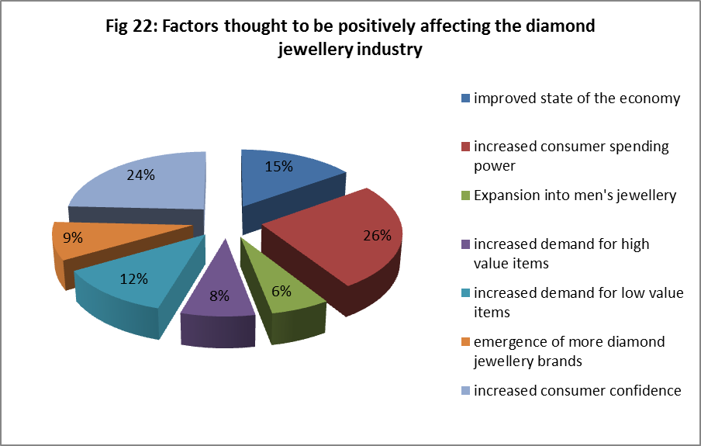
Retailers’ perception about factors affecting the diamond jewellery market
A crucial aspect of this Retail Sentiment Study is to find out the perception of the retailers about the diamond jewellery market. Each of the respondents were asked to state the factors which according to them has been affecting the diamond jewellery market in recent times.
When asked about the positive factors, a majority (26%) of them considered the increased spending behavior among customers to be favouring sales of diamond jewellery. Another notable faction thought that increased consumer confidence has had positive impact on the market. Improved state of the economy too was considered by 15% of them to be favouring diamond jewellery business.
Today there is a rapid emergence
of diamond brands which are
created by diamond jewellers
as a marketing strategy to improve
sales. Interestingly, only 9% of the
retailers believe these new diamond
brands could have done any good to
the market.

Slide 52
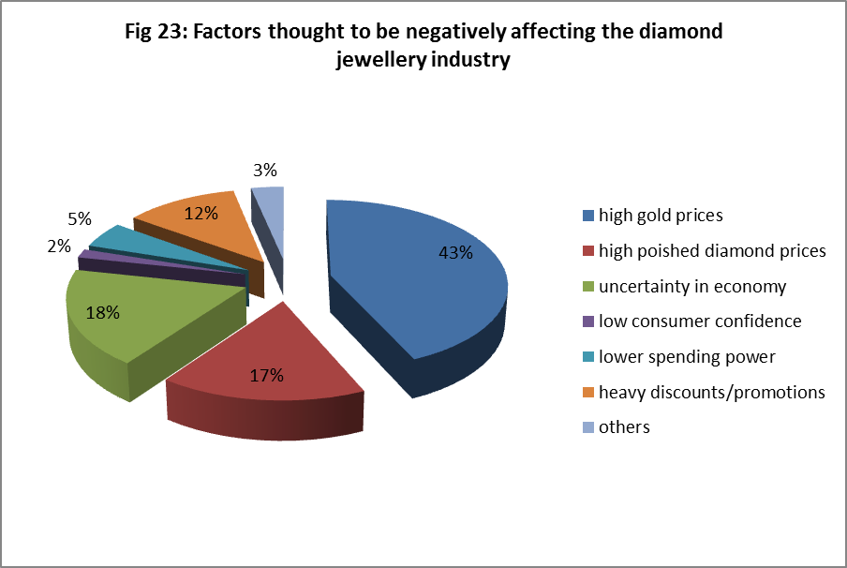
The year 2011 saw a massive rise in the world gold price. Gold is increasingly becoming the best investment alternative. Such a surge in demand for pure gold and pure gold jewellery has crowded out demand for diamond and other types of jewellery. 43% of the retailers reported the same.
Price of polished diamonds in 2011 went up which has raised production cost for diamond ornaments and according to 17% of the retailers have negatively affected the market. Quite a few blamed the uncertainty in economy to have adverse effects on the market. Some of the retailers believed that the sales promotion techniques undertaken by jewellery houses have had negative impact on the market. Sales promotion techniques may not always be successful as they compromise the profit margin of sellers and also make customers compromise their perception of the product’s quality.

Slide 53
DIAMOND JEWELLERY RETAIL SENTIMENT ANALYSIS:
Analysis across Retailer Type

Slide 54
This section attempts to analyze variables across the different types of retailers who participated in the survey. The retailers have been categorized for the same as follows:
Type I: Independent jewellery store (with 1-4 stores)-
These are small jewellery businesses with a small scale of operation and a handful of branches. Most of these retailers design their own diamond jewellery. Some also stock big brands like Nakshatra, Asmi etc.
Type II: Small chain of independent jewellery store (with 5-19 stores)-
These are businesses with medium scale of operation.
Type III: Large chain stores (with 20+ stores)-
These are the big names in the diamond jewellery market. Most are household names like Tanishq, Senco Gold, P C Chandra Jewellers etc. With a large scale of operation their outlets are present in all major Indian cities. Brand outlets of Gitanjali Jewels like Asmi, Nakshatra, Shuddhi Jewels etc. also come under this type.

Slide 55
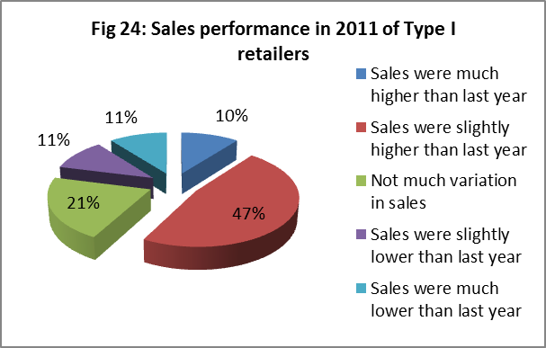
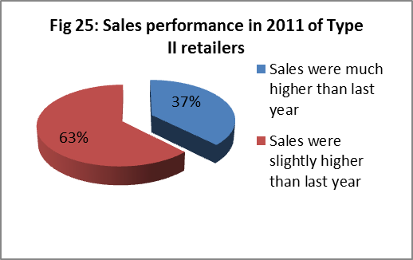
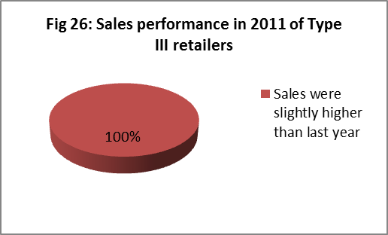
Value sales performance in Year 2011 across retailer type
Out of 19 Type I retailers, 57% reported of having sales higher than in 2010. 22% of them experienced a decline in sales in 2011.
All of the 8 Type II retailers who participated in the survey experienced higher sales in 2011 as compared to 2010. While 5 of them reported of having slightly higher sales, the remaining 3 reported that their sales have been much higher in 2011 than in 2010. Overall all of them experienced higher sales in 2011.
Only 3 retailers of Type III participated in the survey. Data reveals that all of them have had slightly higher sales in 2011 as compared to 2010. Overall all of them experienced higher sales in 2011.
Thus all the Type II and Type III retailers were high performers in 2011 in the context of sales, Type I stores have some mediocre and low sales performers. Jewellers with more than 5 stores in the country have emerged to be better sales performers on analyzing the data. One possible explanation is that the large and fairly large jewellery retailers have a larger scale of operation, larger workforce, larger supply and thus reach out to a large consumer base as compared to the small retailers. Thus it becomes necessary for them to chalk out their sales targets and sales plans in an organized manner because the larger is the base of operation, the higher are the business risks involved. A large retailer also indulges in intensive advertisement of products, offering discounts etc. to pull customers, which a small retailer cannot do because of the large expenses involved. These are some of the reasons behind large retailers achieving better sales performance.

Slide 56
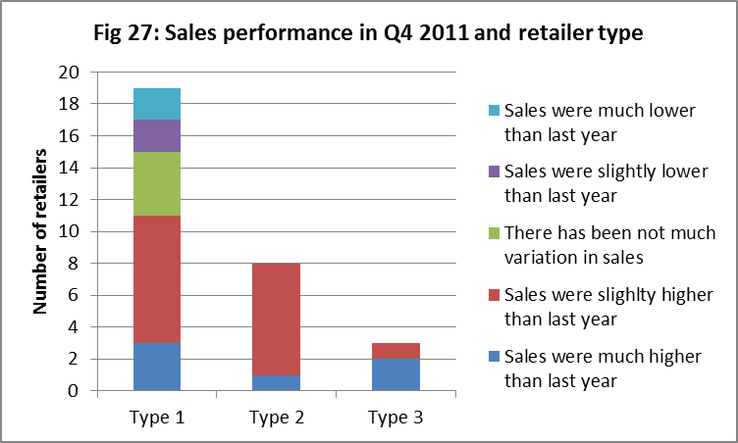
Value sales performance in Q4 2011 across retailer type
Looking at the sales performance of retailers in Q4 2011 it is seen that for most Type I retailers sales were slightly higher as compared to Q4 2010. This was the same scenario as reported by them for the entire year sales in the previous section. Only for 3 retailers sales were much lower in Q4 2011.
For all the Type II retailers sales had gone up in Q4 2011. This is again what they experienced for the entire year of 2011.
Thus for a good number of Type I and all of Type II jewellers sales performance has not only gone up in last quarter of 2011 but also over the entire year.
For 2 out of 3 Type III retailers sales were much higher in Q4 2011. However all reported of having slightly higher sales in entire year 2011. If sales performance over 2011 is considered as an average of sales performances in all the four quarters in 2011 then it can said that sales went down or was about the same in the other quarters of 2011 for the those two retailers.

Slide 57
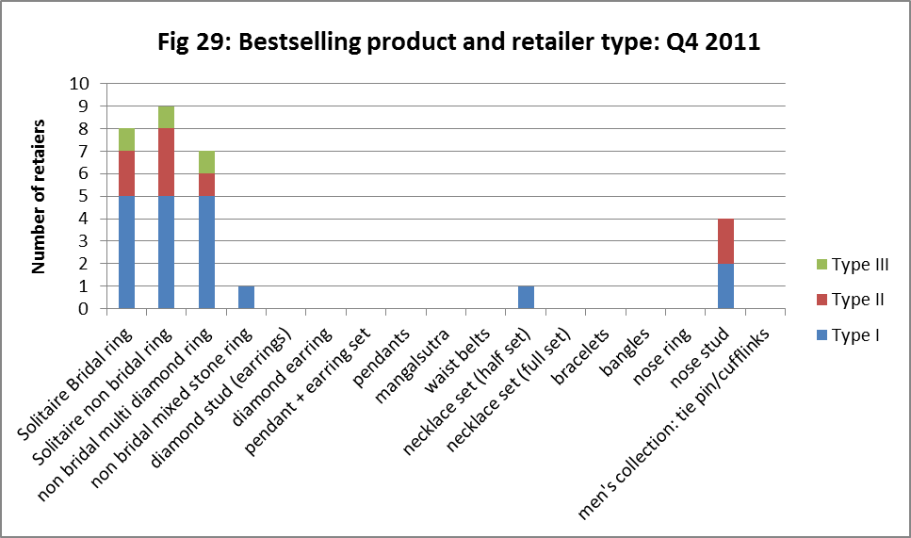
Bestselling product in Q4 2011 across retailer type
The stacked histogram shows the bestselling product for October-December 2011 for the three types of retailers. For 56% of the retailers irrespective of their type, solitaire rings had been the best selling product during what is otherwise considered the Indian festive and wedding season. Other less popular bestselling items were nose studs, non-bridal mixed stone rings and half necklace sets. None of the other items emerged as popular.
For 76% of Type II retailers finger rings (including solitaire bridal rings, solitaire non-bridal rings, non-bridal multi diamond rings and non bridal mixed stone rings) were best sold items in October-December 2011, as opposed to 84% for Type I retailers and 100% for Type III retailers. This means that the large chain stores as well as the small independent stores are able to capture customers demanding finger rings.
Large retailers have ample funds to spend on advertising and offer attractive discounts. Looking at the profiles of the large chain retailers it was found that most of them used diamonds of superior clarity VS1 & VS2 and of colour G/H in their bestselling products and sold them in price range of Rs. 10,000 to Rs. 50,000, an affordable range. Interestingly, exactly the same applied for the Type I retailers whose bestselling products were finger rings. Most Type II retailers used diamonds of Si-3 clarity (relatively inferior to VS1 & VS2), G/H colour and made them available within the price range of Rs. 10,000-25000. Quality conscious customers always look into the Cs (clarity, colour, cut, carat) of diamonds before purchasing, price is also an indicator of quality and this is where the Type I & III retailers score over Type II retailers.

Slide 58
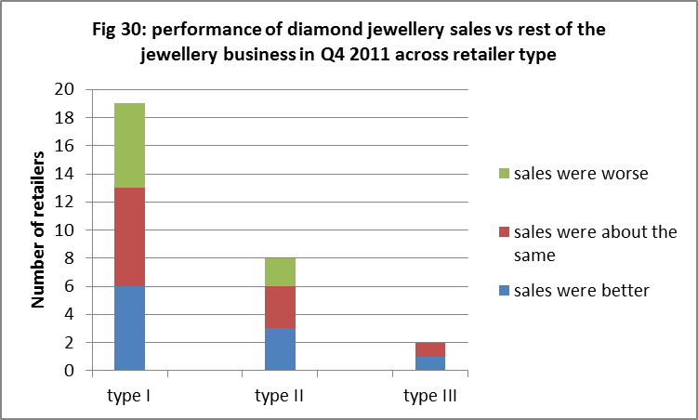
Q4 2011 diamond jewellery sales in comparison with rest of jewellery business across retailer type
The sample for this project includes, among others, the large chain store Asmi which exclusively sells diamond jewellery. Thus this section deals with the other 29 retailers which sell other jewellery apart from diamond. About 38% of retailers irrespective of their type had diamond jewellery rupee sales about the same in October-December 2011 while 27% of them said their other types of jewellery sold better than diamond.
One of the large chain stores which happens to be the largest gold jewellery retail chain in eastern India reported of having better diamond sales than other jewellery sales in Q4 2011. One possible explanation of rupee diamond sales being more than rupee gold jewellery sales is that an average piece of diamond jewellery being more expensive than an average gold jewellery piece. This surge in diamond jewellery sales may also be credited to adoption of various sales boosting methods by the retailer.
Performance of diamond jewellery sales varied among type I retailers with almost an equal number of such retailers facing favourable and unfavourable sales. Looking into the profiles of Type I retailers with unfavourable sales it was found that they ventured chiefly into non-diamond jewellery sales and diamond sales contributed below 10% of their total sales. These retailers concentrate more on boosting non-diamond sales. For retailers with favourable sales, diamond jewellery contributed above 20% of their total annual sales in 2011. These budding jewellery houses pay special emphasis on boosting diamond jewellery sales. This is somewhat the same scenario for Type II retailers.

Slide 59
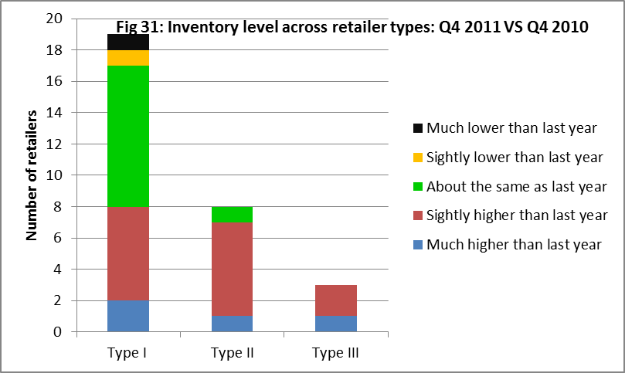
Status of inventory level in Q4 2011 across retailer type
Nearly all the retailers who participated in the survey refrained from reporting their current inventory of diamond jewellery and cut and polished diamonds, however none refused when asked to comment about their current inventory status as compared to 2010. Nearly 47% of the retailers had slightly higher inventory in 2011 as compared to 2010. Only 6% of the retailers had lower current inventory.
Both the retailers with lower inventory were Type I retailers. One of them reported that their inventory of diamond jewellery fell by 45% in Q4 2011. The retailer’s profile showed that its diamond jewellery rupee sales fell by more than 30% in Q4 2011 as compared to the same point of time in 2010 and it was able to sell less than 20 pieces of jewellery. Possibly due to this undesirable experience with diamond jewellery it decided to shift base to non-diamond jewellery sales and hence lowered its inventory. 42 % of type I retailers had higher inventory in Q4 2011. Most type I retailers faced an increase in volume sales in Q4 2011 of 10% to 19% which to an extent explains their high inventory.
A firm may be stocking high inventory to either backup its high sales or due to its inefficiency to sell of its current stocks. All the type III retailers had higher inventory in Q4 2011. Figures for sales performance in Q4 2011 shows that for all three, rupee and volume sales went up more than 20%. All these large retailers have their own collection of diamond jewellery and the customers can have access to their catalogues through the internet, magazines, newspapers etc. This has helped improved sales performance and also increased the need to increase inventory to back up demand for jewellery.
About 87% of type II retailers had higher inventory in Q4 2011 as compared to Q4 2010. Most type II retailers faced an increase in volume sales in Q4 2011 as compared to Q4 2011 of 5%-10%, this explains their increase in inventory.

Slide 60
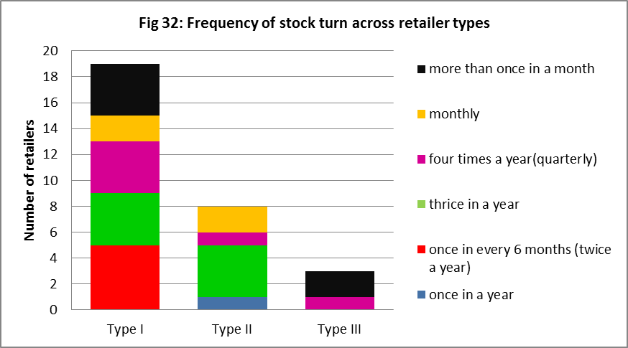
Frequency of stock turn and retailer type
Stock turnover or inventory turnover measures how fast the inventory is moving through a firm and generating sales. Stock turnover reflects the efficiency of inventory management. The higher the ratio, the more efficient is the management of inventories. The stock turn ratio is defined as:
Cost of Goods Sold = No. of times stock is turned
Average Stock
A majority of the retailers (26%) irrespective of their type had stock turn only thrice a year, a fairly low rate in terms of accounting. A good percentage of retailers also had stock turn as high as ‘more than once in a month’.
From the stacked chart the colour black is indicative of very high stock turn ratio and it occurs for type I and type III retailers. All the type III retailers have high stock turnover rates, at least four times a year. This indicates the efficiency with which these large businesses manage their inventories. About 75% of the type I retailers (14 of them) turn stock more than thrice a year. None of these businesses have stock turn as low as once a year.
Most of the type II retailers maintain a slightly low rate of stock turnover of 2 (once in every six months). The most inefficient in inventory management turns out to be a type II retailer which turns stock once in a year.
In terms of accounting a high stock turn rate usually indicates efficiency of business management; however this may not always be true. A high inventory turnover may be caused by a low level of inventory which may result in stock outs, loss of sales and customer goodwill.

Slide 61
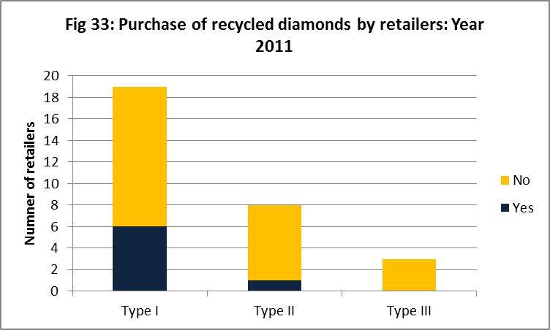
Purchase of recycled diamonds and retailer type
Out of the 30 retailers 23 % purchased recycled diamonds in 2011.
None of the large retailers interviewed purchased recycled jewellery in 2011.
Only one Type II retailer out of 8 (12%) bought used jewellery.
About 31% of the Type I retailers bought used jewellery in 2011. Most of the recycled diamond jewellery was bought by the small retailers.

Slide 62
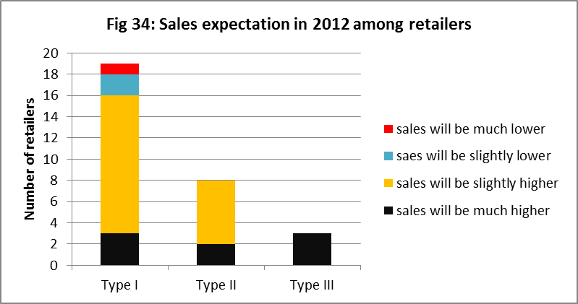
Sales expectation in 2012 and retailer type
About 26% of the retailers irrespective of their type believed that their sales would be much higher in 2012, while 63% of them expected sales to be only slightly higher. Only 3 retailers believed sales in 2012 would not be any better than in 2011.
A majority of those who had very high expectations about 2012 sales also believed that sales would go up by 30%. Most of those who believed sales would rise slightly, expected a 10% rise. Two retailers anticipated sales in 2012 would fall by 20% while one retailer expected a 50% drop.
The stacked chart shows that most of the Type I retailers had high expectations about 2012 and only 15% of them expected otherwise. All the type II & type III retailers had rosy expectations about 2012. Type I retailers who expect higher sales in 2012 comprise mostly of those who sold above 100 pieces in Q4 2011. However even those who sold less than 10 pieces had high expectations about 2012. In fact the retailer whose sales performance in 2011 fell by more than 30% also expected sales in 2012 to be higher by 15%.
Type II retailers expecting prosperous 2012 comprise mostly of those who sold above 100 pieces of diamond jewellery in October-December 2011 and had reported of high sales in 2011. All the large retailers who participated in this survey had reported of having high sales in 2011 as compared to 2010, had sold above 500 jewellery pieces in Q4 2011 and have been very efficient in their inventory management as their stock turn rate reveals. It indeed is likely that their sales performance will be better in 2012.
Sales expectations for 2012 may have been high among these retailers because of the diamond market recovery. Prices of rough diamonds are expected to end the year 2012 higher after a turbulent 2011, due to spurt in consumer demand from United States of America and Asia. According to World Diamond Council president, Eli Izhakoff forecasts for demand in India and China are positive for the entire year 2011.

Slide 63
DIAMOND JEWELLERY RETAIL SENTIMENT ANALYSIS:
Determinants of sales performance

Slide 64
This section deals with the factors which have determined sales performance of diamond jewellery businesses in the year 2011. Some techniques have emerged to be very popular among retailers. Statistical methods have been then used to determine the extent of dependence of sales performance on these dominating factors. Sales performance analysed here is that for the entire year of 2011 and not just Q4 2011. Influence of sales boosting techniques can be better understood on annual sales performance rather than quarterly performance.

Slide 65
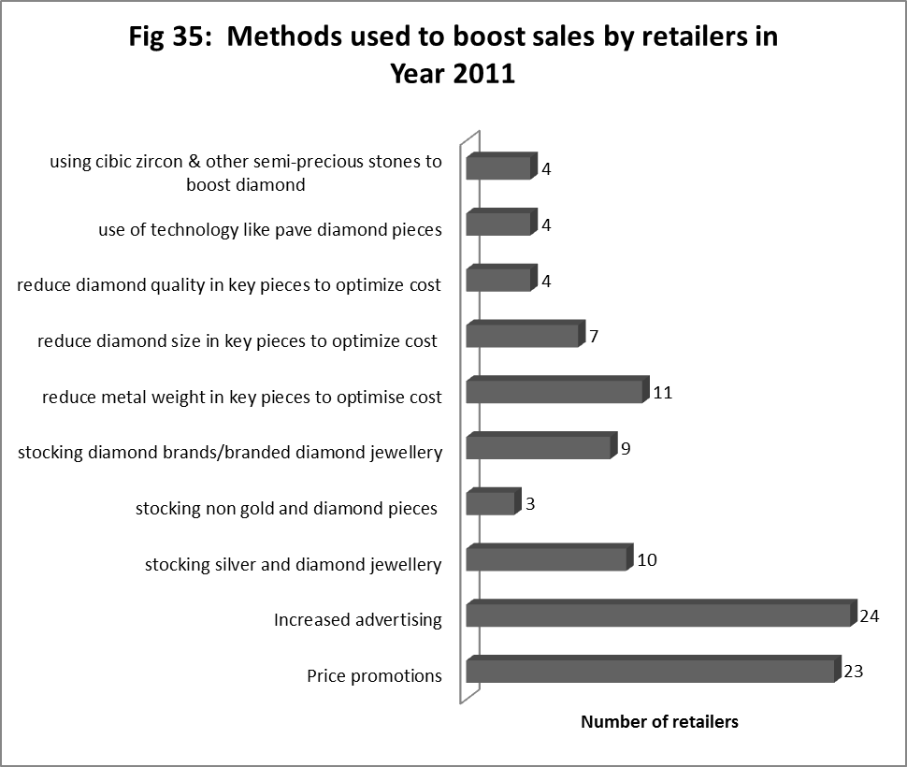
Methods adopted to boost sales in 2011
Increased advertising emerges as the most popular method to boost diamond jewellery sales with 80% of the retailers having used it in the year 2011.
Around 76% of the retailers had used Price promotion techniques, rendering it the second most popular sales promotion method in year 2011.
The market for diamond jewellery can be categorized as a monopolistic competitive market where the players sell products under a brand name. Non price competition with rivals like increased advertising, price promotions, discount schemes to customers etc. is an effective way to enhance market share.

Slide 66
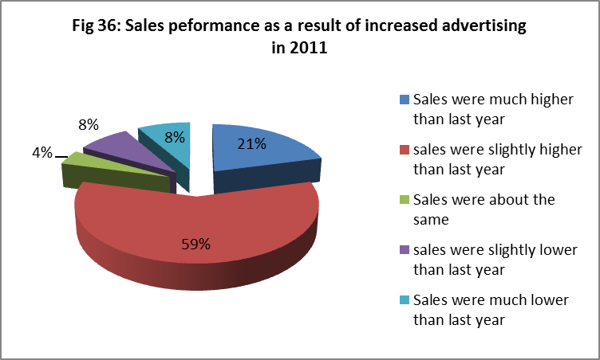
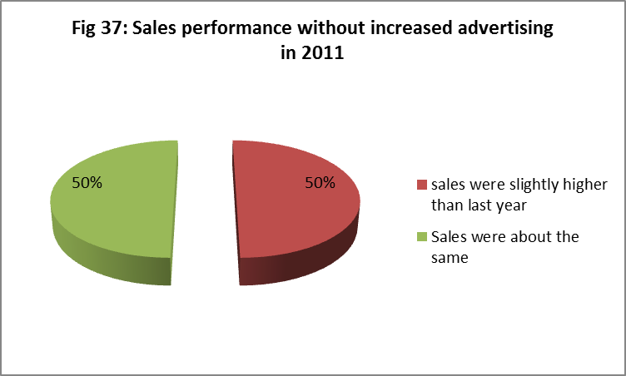
Relationship between increased advertising and sales performance in 2011
Now to determine how has sales in 2011 actually fared for those retailers who did employ this technique. Out of 30 retailers 24 used this technique in 2011.
Sales pie for the 24 retailers who did go for Increased Advertising to boost sales in 2011 is displayed in Fig 36. It shows that for a staggering 80% of the retailers sales were higher ( 59% slightly higher & 21% much higher ) in 2011 as compared to in 2010 with the adoption of increased advertising.
Sales pie for the 6 retailers who did not adopt increased advertising as a sales booster is given in Fig 37. While without adopting increased advertising retailers have not experienced lower sales in 2011, they have not however been able to achieve very high sales either. Only 50% of the retailers attained slightly higher sales in 2011, as compared to 59% of those who adopted it. None reported of achieving very high sales as compared to 21% of those who adopted it.

Slide 67
By assessing the graphs there is a hint of a relationship between adopting increased advertising and Sales performance of retailers in 2011. The actual 2011 sales figures could not be obtained from the retailers, thus sales performance here is basically performance of 2011 diamond jewellery sales as compared to that in 2010. To determine the presence of relationship between increased advertising and sales performance the Chi Square test of Independence of attributes has been conducted. The two variables under consideration are categorical variables or attributes.
The hypotheses for the test:
H0: Increased advertising and Sales Performance are independent variables
H1: Increased advertising and sales performance are dependent variables.
Degrees of freedom= 4
The Chi Square test statistic= 9.87131
Contingency Table
Adopted Increased Advertising | Yes | No | Total
Sales performance in 2011
Sales much higher than previous year | 5 | 0 | 5
Sales slightly higher than previous year | 14 | 3 | 17
Not much variation in sales | 1 | 3 | 4
Sales slightly lower than previous year | 2 | 0 | 2
Sales much lower than previous year | 2 | 0 | 2
Total | 24 | 6 | 30
Since the test statistic value exceeds the critical value 9.488 at 5% level of significance, there is not enough evidence to accept the null hypothesis. The alternative hypothesis is accepted and thus sales performance in the year 2011 (as compared to sales in year 2010) was dependent on increased advertising of products done in 2011 by the retailers.

Slide 68
Ordered Probit Regression Analysis – Sales Performance and its determinants
Data from primary survey has been analysed using regression methods to find out in what manner did the techniques used by retailers to boost sales influence their sales performance for the year 2011. The results obtained may be useful suggestions for others in the diamond jewellery business.
The Ordered Probit Regression method has been applied and the regression analysis has been done using statistical software Stata 9. The variables included are:
Dependent variable:
Y = Sales Performance in 2011 as compared to 2010.
Independent variables:
X1= Price promotions
X2= Increased Advertising
X3= Stocking diamond brands/branded diamond jewellery
X4= Reduce metal weight in key pieces to optimise cost
X5= Reduce diamond size in key pieces to optimize cost
X6= Reduce diamond quality in key pieces to optimize cost
X7= Use of technology like paved diamond pieces
X8=Using cubic zircon & other semi-precious stones to boost diamond sales
x9= Average price of diamond jewellery pieces sold in Q4 2011

Slide 69
The model to be estimated:
Y= α1X1 + α2X2+ α3X3+ α4X4+ α5X5+ α6X6+ α7X7+ α8X8+ α9X9
The coefficients of the 9 regressors show how change in these regressors affects Y.
On running the regression the estimates of regressor coefficients were obtained and each of these were tested using P value test at 5% level of significance. It was found that:
α1= -1.5<0 and is a statistically significant parameter, i.e Price promotions have had an adverse and significant effect on sales performance.
α2 = 0.3>0 and is a statistically insignificant parameter, i.e Inceased Advertising has had a favourable yet insignificant effect on sales performance.
α3 = 2.2>0 and is a statistically significant parameter, i.e Stocking diamond brands/branded diamond jewellery has had a favourable and significant effect on sales performance.
α4 = -2.3<0 and is a statistically significant parameter, i.e Reducing metal weight in key pieces to optimise cost has had an adverse and significant effect on sales performance
α5 = 0.1>0 and is a statistically insignificant parameter, i.e Reducing diamond size in key pieces to optimize cost has had a favourable yet insignificant effect on sales performance.
α6 = -1.7<0 and is a statistically significant parameter, i.e Reducing diamond quality in key pieces to optimize cost have had an adverse and significant effect on sales performance.

Slide 70
α7 = 1.5>0 and is a statistically insignificant parameter, i.e Use of technology like pave diamond pieces has had a favourable yet insignificant effect on sales performance.
α8 = 0.9>0 and is a statistically insignificant parameter, i.e using cubic zircon & other semi-precious stones to boost diamond sales has had a favourable yet insignificant effect on sales performance.
α9 = -0.00001<0 and is a statistically insignificant parameter, i.e the average price of diamond jewellery pieces sold in Q4 2011 has had an adverse and insignificant effect on sales performance.
Sales boosting techniques like that of Increased Advertising, Use of technology like paved diamond pieces, Use of cubic zircon & other semi precious stones, Reducing diamond size in key pieces to optimise cost have favoured Sales performance for the retailers but insignificantly, however Stocking diamond brands/ branded diamond jewellery has significantly favoured sales.
Price promotions (like discount offers etc), Reducing metal weight and reducing diamond quality in key pieces to optimise cost have had significant adverse effect on sales performance. It shows that customers are quality conscious and are not inclined to be thrifty as far as diamond jewellery purchase is concerned.

Slide 71
FINDINGS FROM STUDY

Slide 72
This section highlights some of the major findings in the Diamond Jewellery Retail Sentiment Study. Analysis has been done to assess the sales performance of the 30 retailers interviewed and also the diamond jewellery market trend that had been in the year 2011.The findings are noted below:
A large number of the retailers interviewed (26 out of 30) stock pure gold jewellery. Only 6 stock Platinum jewellery. This gives an insight into the demand scenario of the market to which these jewellers cater to.
For 29 out of 30 retailers diamond jewellery sales constitute less than 40% of total annual sales and this is irrespective of the variety of other types of jewellery they stock in their showroom. Pure Gold jewellery dominates the total annual sales pie on an average, followed by diamond jewellery. Platinum contributes the least.
Most retailers had experienced 10% to 19% increment in diamond jewellery value sales in Quarter 4 2011 as compared to the same period in 2010.
For most retailers (40%) Q4 2011 diamond jewellery sales have been 30%-40% of annual sales in 2011.
For most retailers diamond jewellery sales in Q4 2011 had performed about the same as the rest of the jewellery business.
About 70% of the retailers had sold less than 99 pieces of diamond jewellery in Q4 2011, none sold above 1000 pieces.
For a majority of the retailers volume sales (pieces sales) went up by 10% to 19%, in Q4 2011 as compared to Oct-Dec 2011
For most retailers average price of diamond jewellery pieces sold was less than or equal to Rs. 25,000
Best-selling item for a majority of the retailers in Q4 2011 has emerged to be Solitaire non bridal ring

Slide 73
Comparing value sales in 2011 with that in 2010, for most retailers diamond jewellery sales in 2011 increased by 10% to 19%, a slight increment, same was true for volume sales
For most retailers jewellery belonging to the price range of Rs. 10,000 to Rs. 25,000, of clarity VS1 and VS2, carat range (or size) of 0.02 to 0.07 carats and of colour G/H sold the most in Q4 2011. The most used diamond cut in jewellery making was the round brilliant cut.
About (67%) of the retailers stock their own store brand of diamond jewellery. Only 27% stock Forevermark diamonds.
A majority of the retailers noted a decline in the number of customers asking for branded diamonds/jewellery in the year 2011.
About 43% of the retailers noticed a rise in customers bringing in diamond jewellery to sell.
According to 26% of the retailers increased consumer spending power has been positively affecting the diamond jewellery market. About 24% believed that increased consumer confidence has done good to the market.
A majority of retailers (about 43%) blamed high gold prices in 2011 to have adversely affected the market.
Increased advertising technique was used by 80% of the retailers to boost sales in 2011. About 76% used Price promotion techniques
Chi Square test for dependence of variables reveals that sales performance in the year 2011 was dependent on increased advertising of products done in 2011 by the retailers.
Chi Square test for dependence of variables reveals that Sales performance in 2011 was independent of price promotions.
On analyzing reports of retailers with respect to their business-scale type it was found that:
57% of Type I retailers experienced higher sales in 2011 as compared to the previous year. All the Type II and Type III retailers had higher sales in 2011.

Slide 74
For a good number of Type I and all of Type II jewellers sales performance has not only gone up in last quarter of 2011. Two out of three Type III retailers had experienced very high sales in Q4 2011.
For 76% of Type II retailers finger rings were best sold items in October-December 2011, as opposed to 84% for Type I retailers and 100% for Type III retailers.
Most Type I and Type III retailers used diamonds of clarity VS1 & VS2, of colour G/H in their bestselling products and sold them in price range of Rs. 10,000 to Rs. 50,000. Most Type II retailers used diamonds of Si-3 clarity (relatively inferior to VS1 & VS2), G/H colour and made them available within the price range of Rs. 10,000-25000.
Most of the Type I and Type II and all of the Type III retailers had higher inventory in Q4 2011 as compared to Q4 2010
Most Type I retailers turn stock more than thrice a year. Most of the type II retailers maintain a slightly low rate of stock turnover of 2 (once in every six months). The most inefficient in inventory management turns out to be a type II retailer which turns stock once in a year. All the type III retailers have high stock turnover rates, at least four times a year.
Recycled diamonds were purchased by some Type I and Type II retailers in 2011. None of the Type III retailers did so.
All the Type II and Type III retailers expected sales performance to be higher in 2012. 15% of the Type I expect lower sales in 2012.

Slide 75
Increased advertising emerges as the most popular method to boost diamond jewellery sales with 80% of the retailers having used it in the year 2011.
Around 76% of the retailers had used Price promotion techniques, rendering it the second most popular sales promotion method in year 2011.
According to Chi Square test Sales performance in the year 2011 (as compared to sales in year 2010) was dependent on increased advertising of products done in 2011 by the retailers.
Findings from Regression analysis:
Sales boosting techniques like that of Increased Advertising, Use of technology like paved diamond pieces, Use of cubic zircon & other semi precious stones, Reducing diamond size in key pieces to optimise cost have favoured Sales performance for the retailers but insignificantly, however Stocking diamond brands/ branded diamond jewellery has significantly favoured sales.
Price promotions (like discount offers etc), Reducing metal weight and reducing diamond quality in key pieces to optimise cost have had significant adverse effect on sales performance. It shows that customers are quality conscious and are not inclined to be thrifty as far as diamond jewellery purchase is concerned.

Slide 76
SUGGESTIONS FROM STUDY

Slide 77
On basis of data analysed in this project a few suggestions to retailers are:
To keep in mind that customers are quality conscious as far as diamond jewellery is concerned. Thus as a sales boosting technique they should opt for extensive advertisements of products, use of technology like paved diamond pieces, use of cubic zircon & other semi precious stones, reducing diamond size in key pieces to optimise cost because these have been found to enhance Sales for the retailers however insignificantly. They should consider stocking diamond brands/ branded diamond jewellery as it has been found to have significantly favoured sales.
Price promotions (like discount offers etc), reducing metal weight and reducing diamond quality in key pieces to optimise cost do not go down well with customers, so these methods should be avoided.
Retailers should not compromise on use of diamond clarity and colour.
Retailers should be prepared to capture the customer base during the Indian festive season

Slide 78
LIMITATIONS OF STUDY

Slide 79
This study like any other has come across various limitations, some of which are presented below:
Sample size: The larger is the size of a sample the easier it is to find significant relationships from the data, as statistical tests normally require a larger sample size to ensure a representative distribution of the population and to be considered representative of groups of people to whom results will be generalized or transferred. Thus the size of the sample of 30 is ‘large’ but not large enough poses as a limitation to research
Inability to obtain data: While most of the questions in the questionnaire were answered by the retailers, some questions were not entertained. A majority of the respondents refused to comment or were unsure about the sales to stock ratio of their business. Except for 5 retailers, none revealed their current inventory of diamond jewellery and cut & polished diamonds. Such information is not revealed on account of business secrecy. For this reason no analysis could be conducted on these aspects.
Analysis with approximate information: Some of the data provided by respondents were only approximations. For instance when asked about the percentage change in sales performance in 2011 as compared to 2010 , respondents have not provided the exact figure but only an idea of what they have experienced so far. Also the figure reported by them about the average price of diamond jewellery sold in October-December 2011 is an approximation as well on basis of the most sold price ranges of the bestselling items. Analysis from approximate data suffers from inaccuracy.

Slide 80
BIBLIOGRAPHY

Slide 81
“Diamond Markets in Recovery Mode - Special Report”, Rapaport Research, January 2011
<http://www.diamonds.net/cms/PDFs/Price-Statement_Update_011811_V2>
Diamond”, Wikipedia – The Free Encyclopedia
<http://en.wikipedia.org/wiki/Diamond>
“History of Diamonds”, Ernest Jones Love & Life
<http://www.ernestjones.co.uk/webstore/static/diamond-buyers-guide/diamond-history.do>
“Indian Diamond Industry”
<http://www.ieo.org/diamond.html>
Jeffrey M. Woolridge, “Econometric Analysis of Cross Section and Panel Data”, The MIT Press
“Pricing Diamond Jewellery”
<http://www.thediamonddirectory.com/articles/pricing_diamond_jewelry.htm>
“Research Methodology - An Introduction”
<http://www.newagepublishers.com/samplechapter/000896.pdf>
“The Global Diamond Industry – Lifting the veil of mystery”, Bain & Company, 2011
<http://www.bain.com/Images/PR_BAIN_REPORT_The_global_diamond_industry.pdf>
“The News Room”, IDEX International Diamond Exchange
<idexonline.com>
“Truth about Diamonds- opening the eyes of the diamond consumer”, IGI Diamond Certification
<http://www.truthaboutdiamonds.com/truth-about/diamond-certificates-gia-ags-igi-hrd-egl/igi/>
“The Diamond Industry Fact Sheet”, World Diamond Council
<http://www.worlddiamondcouncil.org/download/resources/documents/Fact%20Sheet%20(The%20Diamond%20Industry).pdf>
<http://www.debeersgroup.com/>
<imrbint.com>

Slide 82
ACKNOWLEDGEMENT

Slide 83
This project would not have been possible without the endless support, guidance and advice of the project heads at IMRB International (Abacus Business Operations, Kolkata); Gatekeeper Project Teamleader Mr. Gaurab Banerjee, Mahindra & Mahindra Project Teamleader Mr. Soumya Chakraborty, Wills Lifestyle Mystery Audit Teamleader Ms. Mayuri Biswas, De Beers Project Teamleader Mr. Rajat Sengupta. Also without the advice of Field Manager Mr. Rajarshi Ray this presentation would have been impossible. I would like to specially thank the entire staff at Abacus Business Operations, Kolkata for making my experience as an intern extremely resourceful.
I am sincerely grateful to Dr. Arpita Dhar, Economics Department, Jadavpur University for guiding me through the regession analysis of data. Without her endless support and encouragement a vital portion of analysis would not have been possible.

